Slide 1
Operating System(22516) Unit 1 : Overview of Operating System Hours: 06 Marks: 08
Prepared by:
Mrs. Kousar Ayub A.
Lecturer(Selection Grade)
Computer Engg. Dept
M. H. Saboo Siddik Polytechnic

Slide 2
Learning Outcomes
The learners will be able to:
Operating System(OS) Concept
Components of OS
Operations of OS
Views of OS
Different Types of Operating Systems
Batch OS
Multi Programmed OS
Time Shared OS
Multiprocessor Systems
Distributed Systems
Real Time Systems
Mobile OS
Command Line & GUI Based OS.

Slide 3

What is an Operating System?
A program that acts as an intermediary between a user of a computer and the computer hardware.
Eg :-Windows 10, Windows 8, Apple's mac OS & Linux
Operating system goals:
Execute user programs and make solving user problems easier.
Make the computer system convenient to use.
Use the computer hardware in an efficient manner.

Slide 4
Computer System Components
1. Hardware – provides basic computing resources (CPU, memory, I/O devices).
2. Operating system – controls and coordinates the use of the hardware among the various application programs for the various users.
3. Applications programs – define the ways in which the system resources are used to solve the computing problems of the users (compilers, database systems, video games, business programs).
4. Users (people, machines, other computers).

Slide 5
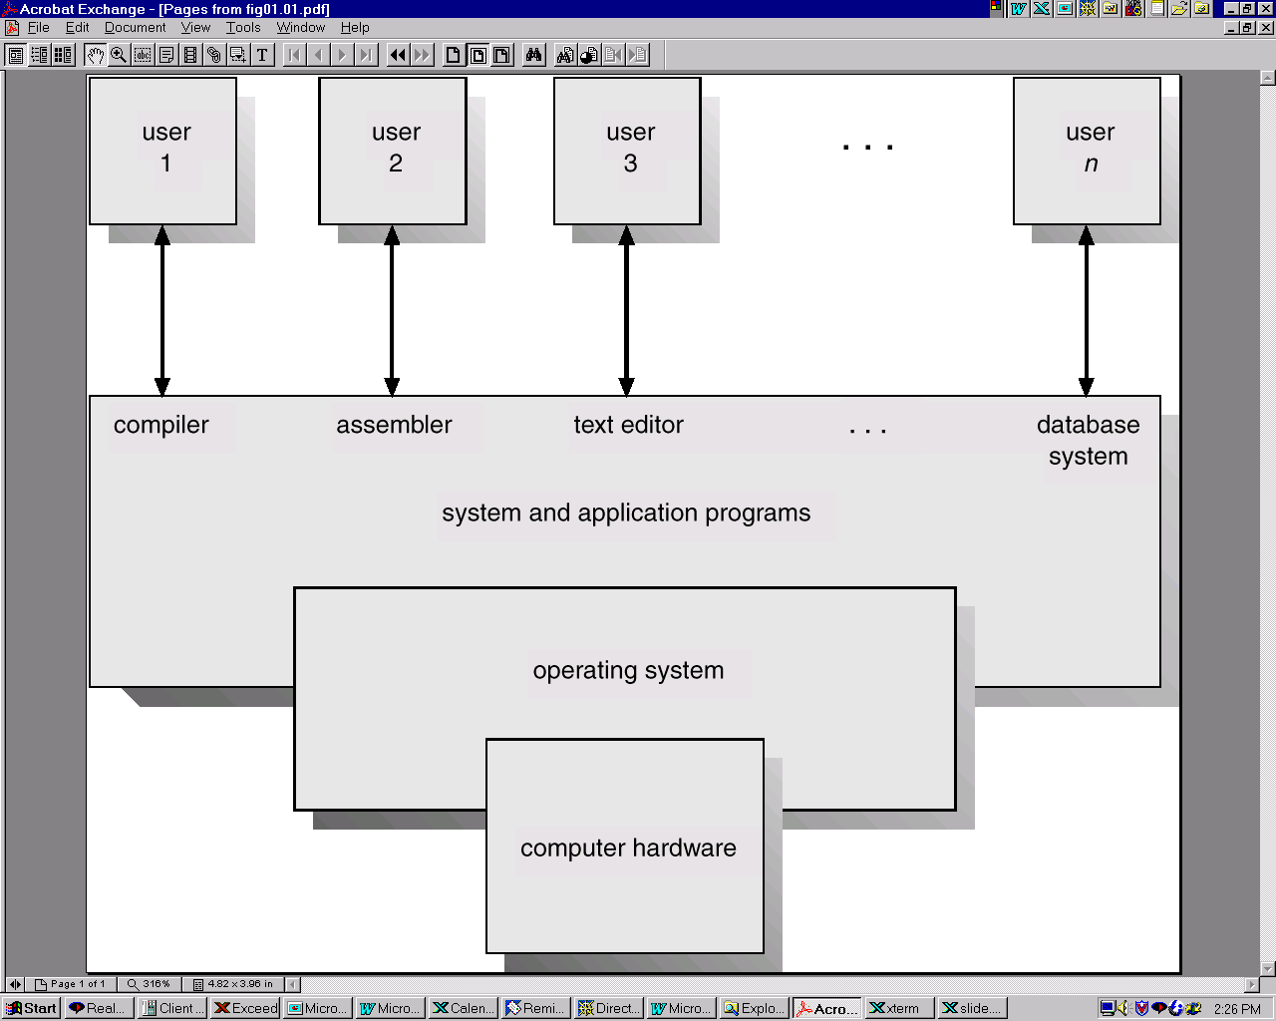
Abstract View of System Components

Slide 6
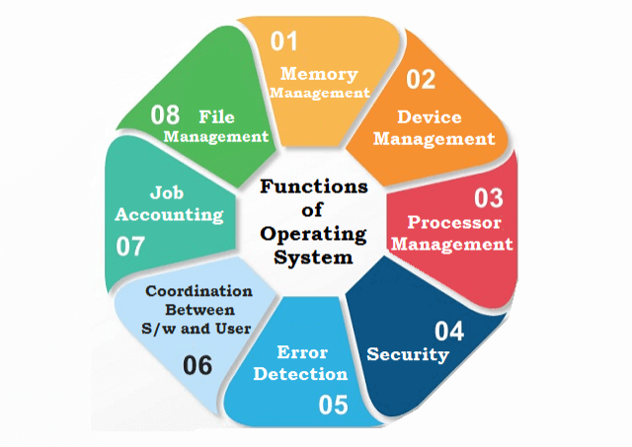
Operations /Functions/Services of OS
Memory Management
Device Management
Processor Management
Security
Error detecting aids
Coordination between other
software and users
Job accounting
File Management

Slide 7
Cont……
Memory Management
Keeps tracks of primary memory, i.e., what part of it are in use by whom, what part are not in use.
Allocates the memory when a process requests it to do so.
De-allocates the memory when a process no longer needs it or has been terminated.
Processor Management
Keeps tracks of processor and status of process. The program responsible for this task is known as traffic controller
Allocates the processor (CPU) to a process.
De-allocates processor when a process is no longer required.

Slide 8
Cont……
Device Management
Keeps tracks of all devices. The program responsible for this task is known as the I/O controller.
Decides which process gets the device when and for how much time.
Allocates the device in the most efficient way.
De-allocates devices.
File Management
Keeps track of information, location, uses, status etc. The collective facilities are often known as file system.
Decides who gets the resources.
Allocates the resources.
De-allocates the resources.

Slide 9
Cont……
Security :-By means of password and similar other techniques, it prevents unauthorized access to programs and data.
Job accounting :-Keeping track of time and resources used by various jobs and users.
Error detecting aids :- Production of dumps, traces, error messages, and other debugging and error detecting aids.
Coordination between other software and users :- Coordination and assignment of compilers, interpreters, assemblers and other software to the various users of the computer systems.

Slide 10
Operating System ─ Types
Batch Operating System
Multiprogramming operating system
Time-sharing Operating Systems
Distributed Operating System
Real-Time Operating System

Slide 11
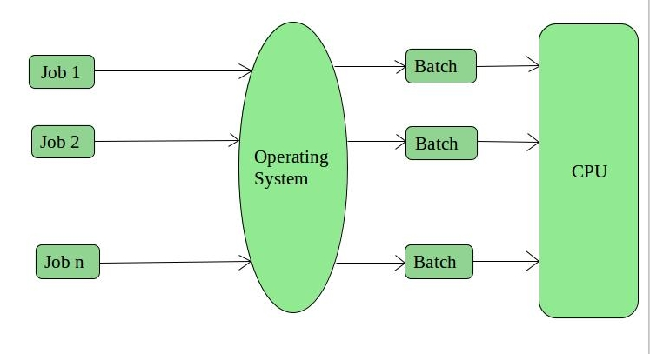
Batch Operating System
This type of operating system does not interact with the computer directly. There is an operator which takes similar jobs having same requirement and group them into batches. It is the responsibility of operator to sort the jobs with similar needs.

Slide 12
Batch OS
In a punch card system, human intervention was required for each punch card, which was an overhead.
Thus in Batch Systems, a collection of cards known as batch used to submit reducing human intervention.
2 Types of Cards were used :
1. Data Cards : used to contain actual information
2. Control Cards : Used to control the flow of execution.

Slide 13
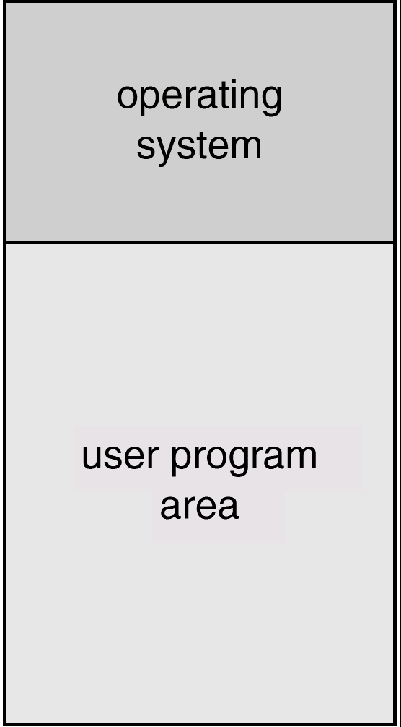
Memory Layout for a Simple Batch System

Slide 14
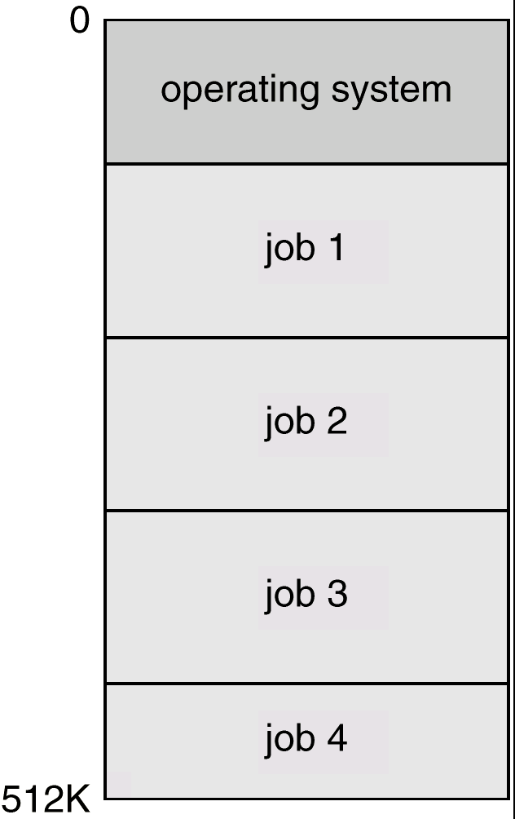
Multiprogrammed Systems
Several jobs are kept in main memory at the same time, and the CPU is multiplexed among them.

Slide 15
OS Features Needed for Multiprogramming
I/O routine supplied by the system.
Memory management – the system must allocate the memory to several jobs.
CPU scheduling – the system must choose among several jobs ready to run.
Allocation of devices.

Slide 16
Multiprocessor Systems(Parallel Systems)
Multiprocessor systems with more than on CPU in close communication.
Tightly coupled system – processors share memory and a clock; communication usually takes place through the shared memory.
Advantages of parallel system:
Increased throughput
Economical
Increased reliability
graceful degradation
fail-soft systems

Slide 17
Parallel Systems (Cont.)
Symmetric multiprocessing (SMP)
Each processor runs and identical copy of the operating system.
Many processes can run at once without performance deterioration.
Most modern operating systems support SMP
Asymmetric multiprocessing
Each processor is assigned a specific task; master processor schedules and allocated work to slave processors.
More common in extremely large systems

Slide 18
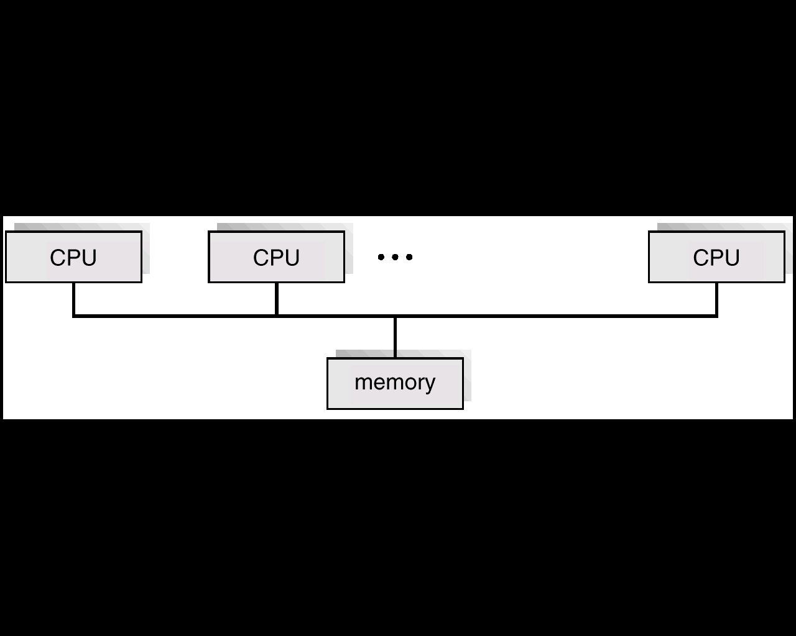
Symmetric Multiprocessing Architecture

Slide 19
Distributed Systems
Distribute the computation among several physical processors.
Loosely coupled system – each processor has its own local memory; processors communicate with one another through various communications lines, such as high-speed buses or telephone lines.
Advantages of distributed systems.
Resources Sharing
Computation speed up – load sharing
Reliability
Communications

Slide 20
Distributed Systems (cont)
Requires networking infrastructure.
Local area networks (LAN) or Wide area networks (WAN)
May be either client-server or peer-to-peer systems.

Slide 21
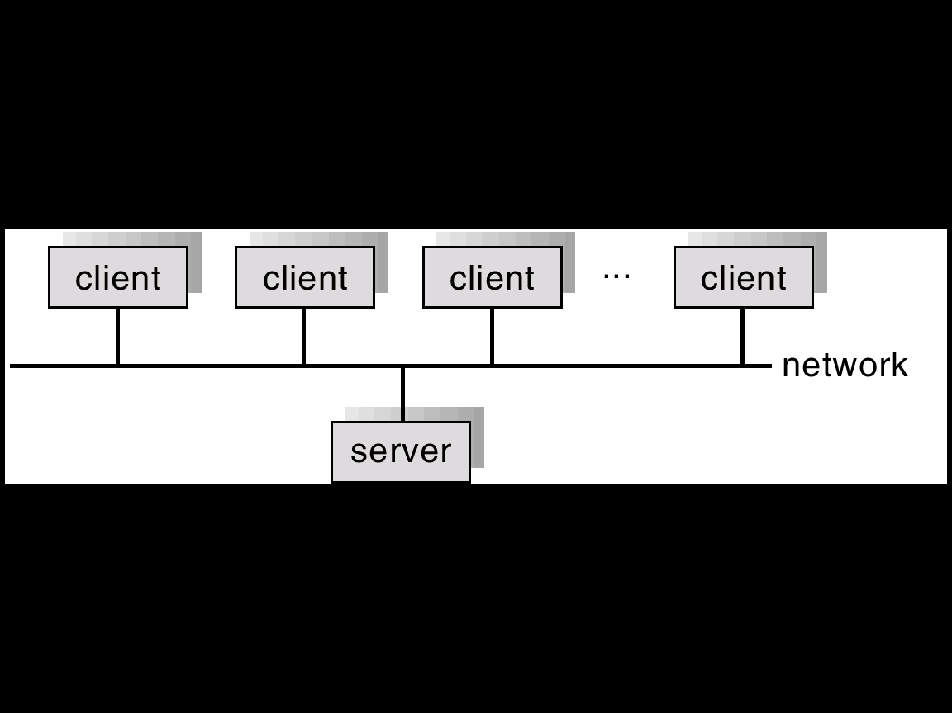
General Structure of Client-Server

Slide 22
Real-Time Systems
Often used as a control device in a dedicated application such as controlling scientific experiments, medical imaging systems, industrial control systems, and some display systems.
Well-defined fixed-time constraints.
Real-Time systems may be either hard or soft real-time.

Slide 23
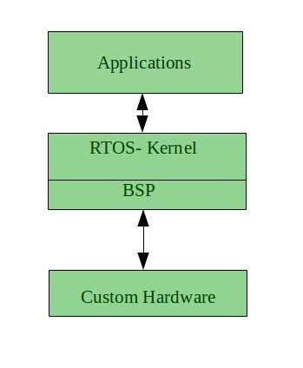
Real-Time Systems

Slide 24
Real-Time Systems (Cont.)
Hard real-time:
Secondary storage limited or absent, data stored in short term memory, or read-only memory (ROM)
Conflicts with time-sharing systems, not supported by general-purpose operating systems.
Soft real-time
Limited utility in industrial control of robotics
Useful in applications (multimedia, virtual reality) requiring advanced operating-system features.

Slide 25
Mobile OS
A mobile OS is a software that allows smartphones, tablet PCs and other hand held devices to run applications and programs.
Common Mobile OS
Android
ios
Windows
KaiOS

Slide 26
Command Line & GUI Based OS
Command Line Based OS :
This Permits user to interact with system using commands.
Example : DOS, UNIX etc.
GUI Based OS :
This Permits user to interact with system using graphical controls.
Example : Windows, LINUX etc.

Slide 27
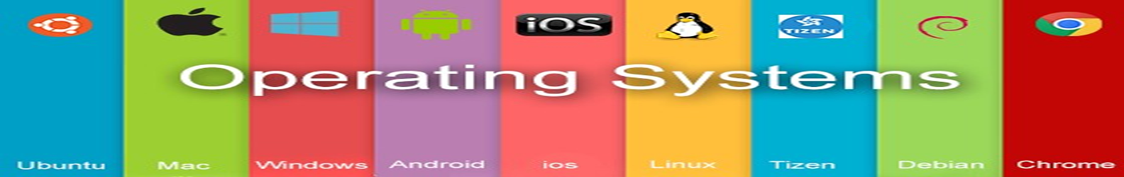
EXAMPLE

Slide 28
Thank you…..
You can mail your Queries to :
a2kousarj@gmail.com

